Slide 1

Problem Definition
Chapter 6
Business Research Methods - William G. Zikmund

Slide 2
Problem Definition - Introduction
Problem definition - process of defining and developing a decision statement and the steps involved in translating it into more precise research terminology, including a set of research objectives.
A decision statement is a written expression of the key question(s) that a research user wishes to answer
Sudha Bhagavatheeswaran, Department of Information Technology,
SIES College of Arts, Science & Commerce (Autonomous)

Slide 3
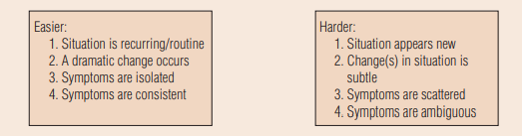
Problem Complexity
01
Situation frequency
Dramatic Changes
02
How widespread are the symptoms?
Symptom Ambiguity
04
03
Sudha Bhagavatheeswaran, Department of Information Technology,
SIES College of Arts, Science & Commerce (Autonomous)
Notes:
© Copyright PresentationGO.com – The free PowerPoint and Google Slides template library

Slide 4
The Problem-Definition Process
Problems Mean Gaps
  Business performance is worse than expected business performance.
  Actual business performance is less than possible business performance
  Expected business performance is greater than possible business performance
Sudha Bhagavatheeswaran, Department of Information Technology,
SIES College of Arts, Science & Commerce (Autonomous)

Slide 5






The Problem-Definition Process Steps
Probing
Identify Relevant Issues
Situation Analysis
Interview Process
Interrogative Techniques

Slide 6
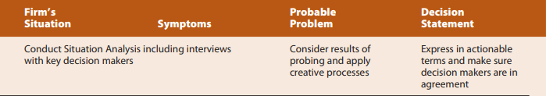
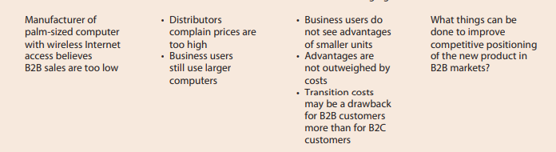
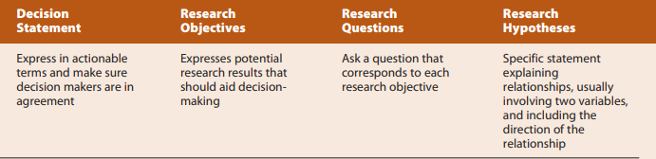
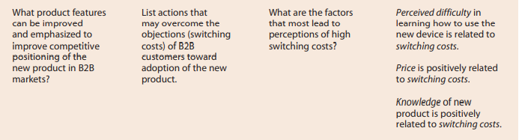
Writing Managerial Decision Statements and Corresponding Research Objectives

Slide 7
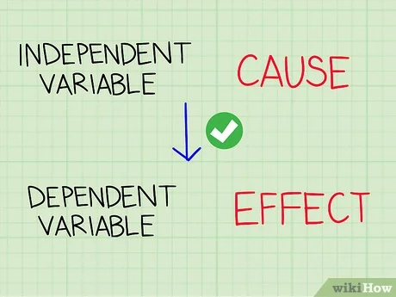
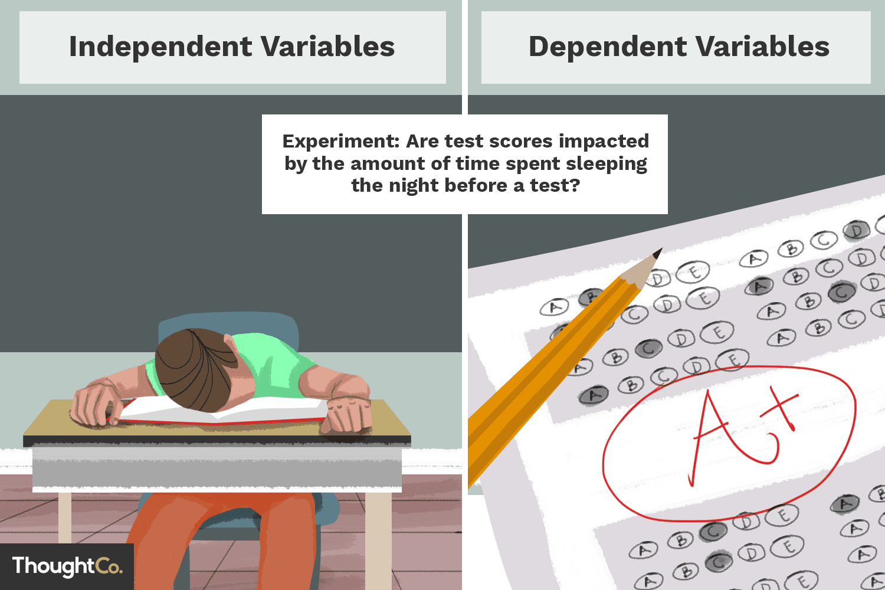
Sudha Bhagavatheeswaran, Department of Information Technology,
SIES College of Arts, Science & Commerce (Autonomous)

Slide 8
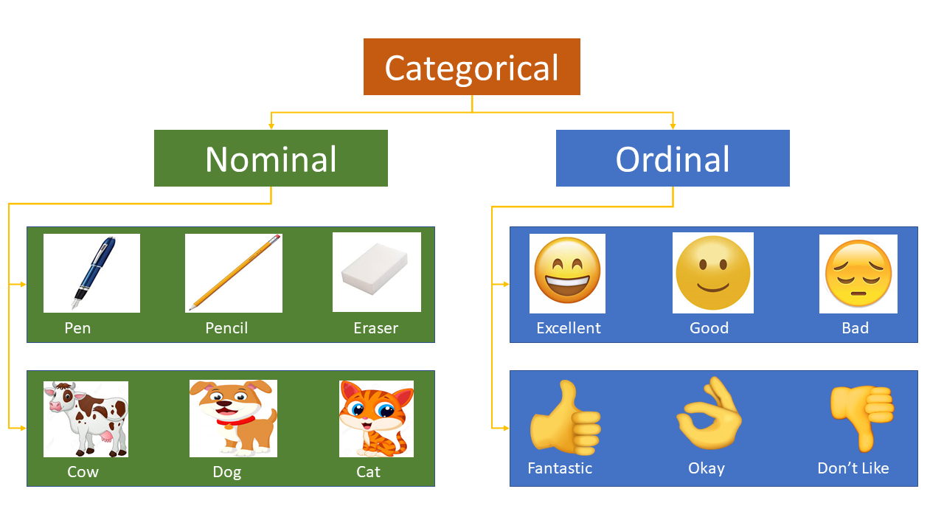

Slide 9
